Slide 1


Unilever iOps Platform:
Using Big Data Analytics to get data driven insights from Sales data
Presented by
Mohammed Sarshaar

Slide 2
Industry Overview and Business Problem
Unilever is a multinational consumer goods company, known for its diverse portfolio of products
It operates in over 190 countries and owns more than 4000 brands.
Unilever emphasizes sustainability and social responsibility, integrating these principles into its business strategy.
Business Problem and Challenges:
Data Silos
Manual Analysis
Limited Insights
Data is scattered across different systems, making it difficult to gain a holistic view of the customer.
Traditional methods rely on manual data processing, which is time-consuming and prone to error.
Traditional methods often fail to uncover hidden patterns and trends in the data.

Slide 3
Implementing Big Data Solution
Big data solutions like Hadoop and Apache Spark can easily scale to handle increasing amounts of data, allowing organizations to process and analyze massive datasets without performance degradation.
These technologies enable distributed computing, where data is processed across multiple servers or nodes. This parallel processing speeds up data analysis and reduces the time required for insights.
Data Integration and Management
Extracting data from multiple sources.
Data Cleansing and Transformations
Data Cleansing
Big Data Analysis
Performing Data Science and ML activities to derive useful insights.
Data Storage into suitable data sources
Using Visualization tools for reporting
Implementing data transformations as per business logic.

Slide 4
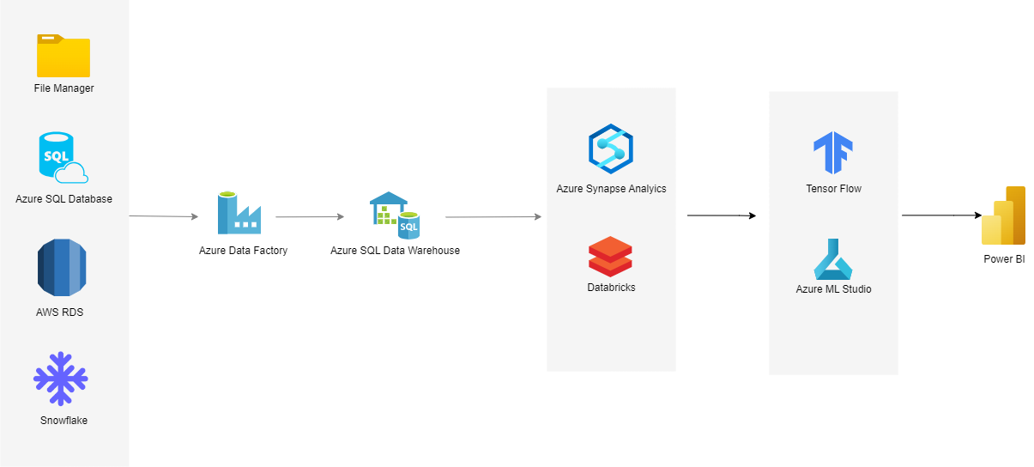
Technical Architecture Diagram

Slide 5
1. Data Integration and Management
Data is ingested into cloud from multiple data sources like File System, SQL Database, Snowflake, AWS RDS
Data is extracted using orchestrating tool like Azure Data factory
Data is stored in a central repository like Azure lake store or Azure SQL Datawarehouse
Data Sources
Data Integration
Data Storage

Slide 6
2. Data Cleansing and Transformations
Data Cleansing:
Data cleansing is a crucial process in data management that involves identifying and correcting errors or inconsistencies in data to improve its quality.
Data Transformation:
Data transformation is used to convert data into required format as per business requirement which can be further utilized for Big Data Analytics.
This is done using Python, Apache Spark or R scripting language.
Analytical Tools such as Databricks and Azure Synapse Analytics are used to perform transformations

Slide 7
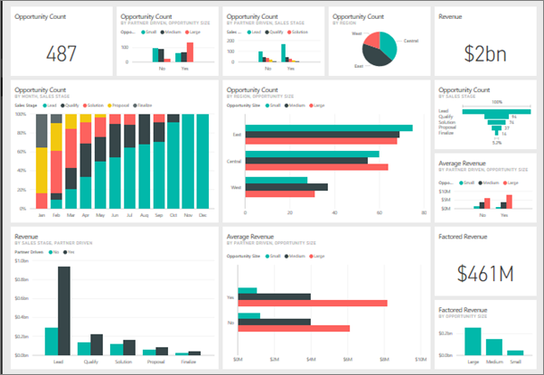
3. Big Data Analysis
Big data analytics refers to the process of examining large and complex datasets to uncover hidden patterns, correlations, and insights that can inform decision-making. It leverages advanced analytics techniques and technologies to process and analyze vast amounts of structured and unstructured data.
It includes performing Data Science and Machine Learning Operations to build predictive model.
Various Modelling techniques include Regression, Classification, Time Series, Random Forest Analysis
Tensor Flow, Azure Machine Learning Studio are some of the examples of Data Science platforms
Tools for visualizing data insights to facilitate better understanding and decision-making include
Power BI and Tableau.

Slide 8
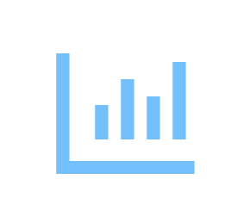



Analysis and Insights
Sales Performance Analysis
Customer Segmentation
Identifying top-performing products, regions, and customer segments.
Developing tailored marketing campaigns based on customer preferences.
Market Trend Identification
Risk Assessment
Spotting emerging trends and opportunities for product innovation
Predicting potential sales declines and identifying mitigating strategies.

Slide 9
Conclusion
Unilever's big data initiative empowers the organization to make data-driven decisions, optimize operations, and enhance customer experiences. Continuously evolving the data infrastructure, exploring advanced analytics techniques, and fostering data literacy across the organization are essential next steps to maximize the benefits of Big Data.

